Slide 1
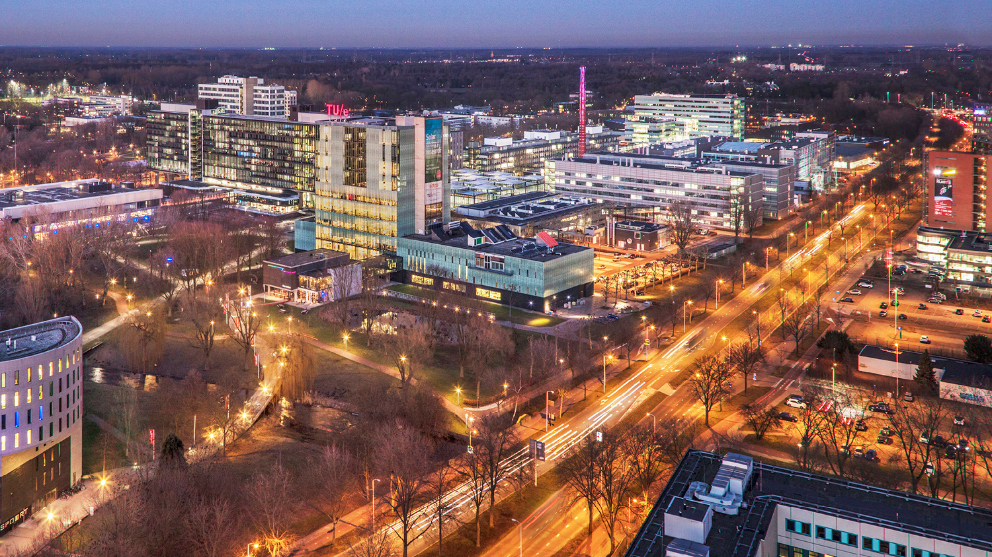
2021 AutoRef – Meeting III
Tuesday, 02 March 2022
Guilherme, Project Manager, PDEng Trainee MSD 2022
1
2o21 MSD AutoRef Project
1

Slide 2
AGENDA
Project progress
Decision-making matrix
Technology proposal
Questions from the team
2o21 MSD AutoRef Project

Slide 3

AutoRef - Progress
 | Week
Project activities schedule | 1 | 2 | 3 | 4 | 5 | 6
 | 10/02-17/02 | 17/02-24/02 | 24/02-03/03 | 03/03-10/03 | 10/03-17/03 | 17/03-24/03
Project Management Plan creation
2020 MSD project documents review
Hardware and software options evaluation
Project scope definition
New requirements creation
System architecture definition
Software creation
Software integration
Systems test
Real robot soccer match simulation
Documentations and main deliverables finished
2o21 MSD AutoRef Project

Slide 4
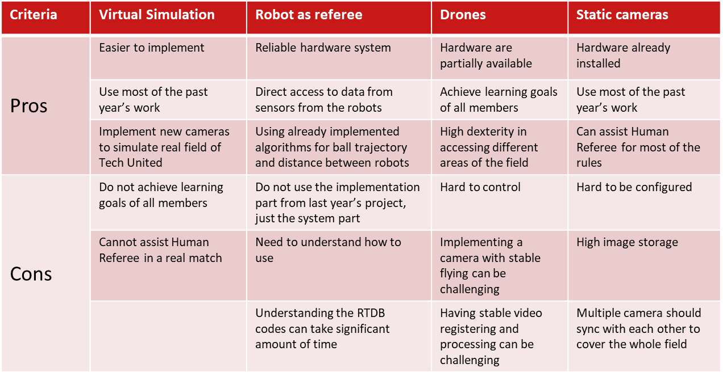
AutoRef - Progress
2 weeks Feasibility phase:
Presentation about each technology feasibility and Pros/Cons table

Slide 5
AutoRef - Progress
Decision-making for the feasibility phase:

Slide 6
Questions:
What rules are difficult to be interpreted by the Human Referee?
Does the referee receive any information from the robot?
What rules will be violated in the game?
What means the word autonomous in the context?
When it will be the mid project presentation?
2o21 MSD AutoRef Project

